Slide 1
Linear Regression

Slide 2
Regression as a concept was first introduced by Francis Galton in 1877.
He introduced the word “regress”, which means going back to the “mean” of a given population, during a research on estimating heights of children of tall parents.

Slide 3
What is Regression?
In data analytics we come across the term “Regression” very frequently.
Before we continue to focus topic i.e. “Linear Regression” lets first know what we mean by Regression.
Regression is a statistical way to establish a relationship between a dependent variable and a set of independent variable(s). e.g., if we say that
Age = 5 + Height * 10 + Weight * 13
Here we are establishing a relationship between Height & Weight of a person with his/ Her Age. This is a very basic example of Regression.

Slide 4
Understanding Linear Regression
Independent Variable
The value of an independent variable does not change based on the effects of other variables.
An independent variable is used to manipulate the dependent variable. It is often denoted by an “x.”
In our example, the rainfall is the independent variable because we can’t control the rain, but the rain controls the crop—the independent variable controls the dependent variable.
Dependent Variable
The value of this variable changes when there is any change in the values of the independent variables, as mentioned before. It is often denoted by a “y.” In our example, the crop yield is the dependent variable, and it is dependent on the amount of rainfall.

Slide 5
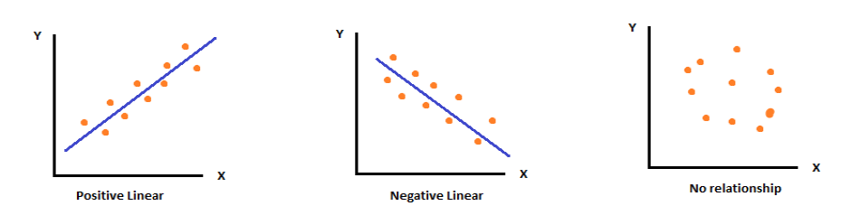
Types of Relationship
Simply Regression specifies relationship between two or more variables (Xn and Y)
Tells about the nature of relationship (Positive, Negative etc)
A scatterplot is used to plot the above graphs to determine the type of relationship between variables
Shows trend – upward, downward etc.

Slide 6
Types of Regression
Simple Linear Regression
If a single independent variable is used to predict the value of a numerical dependent variable, then such a Linear Regression algorithm is called Simple Linear Regression.
Multiple Linear Regression
If more than one independent variable is used to predict the value of a numerical dependent variable, then such a Linear Regression algorithm is called Multiple Linear Regression.
Polynomial Linear Regression
Polynomial regression is a special case of linear regression where we fit a polynomial equation on the data with a curvilinear relationship between the target variable and the independent variables.
In a curvilinear relationship, the value of the target variable changes in a non-uniform manner with respect to the predictor (s).

Slide 7
Applications of Linear Regression
Economic Growth
Linear regression is used to determine the economic growth of a country or a state in the upcoming quarter.
It can also be used to predict a nation’s gross domestic product (GDP).
Product Price
Linear regression can be used to predict what the price of a product will be in the future, whether prices will go up or down.
Housing Sales
Linear regression can be used to estimate the number of houses a builder will sell in the coming months and at what price.
Score Predictions
Linear regression can be used to predict the number of runs a baseball player will score in upcoming games based on previous performance.

Slide 8
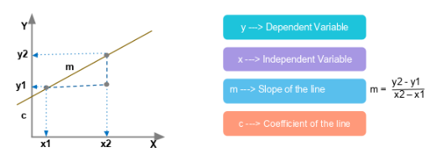
Regression Equation
The simplest linear regression equation with one dependent variable and one independent variable is:
y = m*x + c
Look at this graphic:

Slide 9
We have plotted two points, (x1,y1) and (x2,y2).
Let’s discuss the example of crop yield and plot the crop yield based on the amount of rainfall.
Here, rainfall is the independent variable and crop yield is the dependent variable.

Slide 10
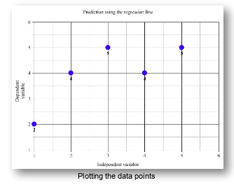
x | y
1 | 2
2 | 4
3 | 5
4 | 4
5 | 5
Next, we calculate the means, or average values, of x and y.
The average of the x values is 3, and the average of the y values is 4.
We plot both means on the graph to get the regression line.

Slide 11
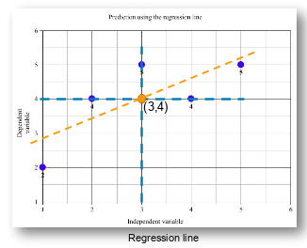

Slide 12
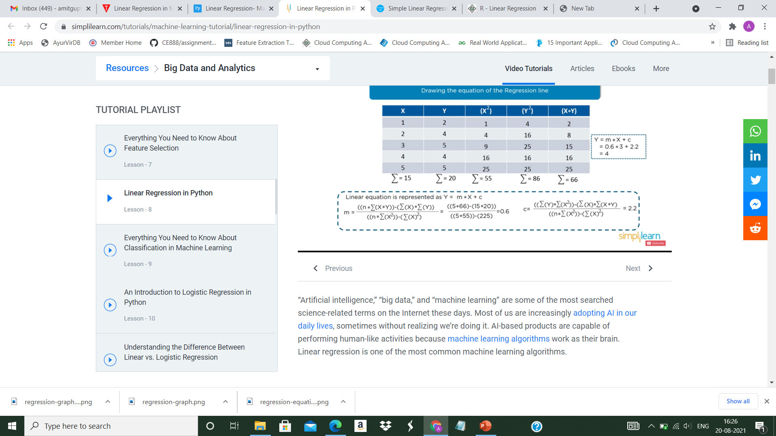
m = 0.6
c = 2.2

Slide 13
Steps to Calculate the Slope(m) and Intercept(c)
Slope (m​):
The slope is the amount by which y (the dependent variable) changes for a unit change in x (the independent variable).
The formula for calculating the slope is:
m = ∑ (xi-x‾)(yi-y‾) / ∑ (xi-x‾)²
Where:
xi and yi are individual data points of the independent and dependent variables,
xˉ is the mean of the independent variable xxx,
yˉ is the mean of the dependent variable yyy.

Slide 14
Intercept (c​):
The intercept is the value of y when x=0x = 0x=0. It is the point where the regression line crosses the y-axis.
The formula for the intercept is:
c = yˉ−m⋅xˉ
Where:
yˉis the mean of the dependent variable y,
xˉis the mean of the independent variable x,
m​ is the slope calculated earlier.

Slide 15
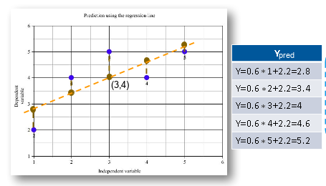
Let’s find out the predicted values of y for corresponding values of x using the linear equation in which m = 0.6 and c = 2.2 and plot them.

Slide 16
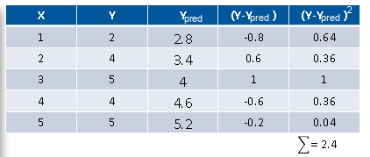
Here, the blue points represent the actual y values, and the brown points represent the predicted y values based on the model we created.
The distances between the actual and predicted values are known as residuals or errors.
The best-fit line should have the lowest sum of squares of these errors, also known as “e square.”

Slide 17
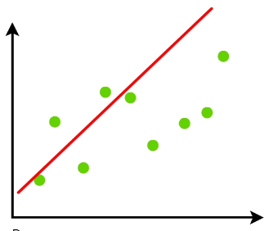
You can observe that the sum of squared errors for this regression line is 2.4.
We check this error for each line and determine the best-fit line having the lowest e square value.
The graphical representation is:

Slide 18
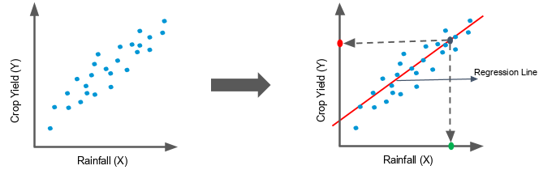
Here, we’ve drawn a line through the middle of the data.
The red point on the y-axis is the crop yield you can expect for the amount of rainfall (x) represented by the green dot.
If we have an idea about the amount of rainfall for a year, then we can predict how plentiful our crop will be.

